Slide 1
Automatic teller Machine(ATM)
CREATED by: Aayush Gautam
Programming language: python

Slide 2
Purpose of the projects:
* Ask for the register users name.
* Ask for register user pin.
* If the data is correct it will display the account number and available balance to valid user otherwise display invalid data.
* Than program will ask user weather they want to deposit/withdrwal or do no transaction.
* Lastly, program execute to user with greetings. End of the program.

Slide 3
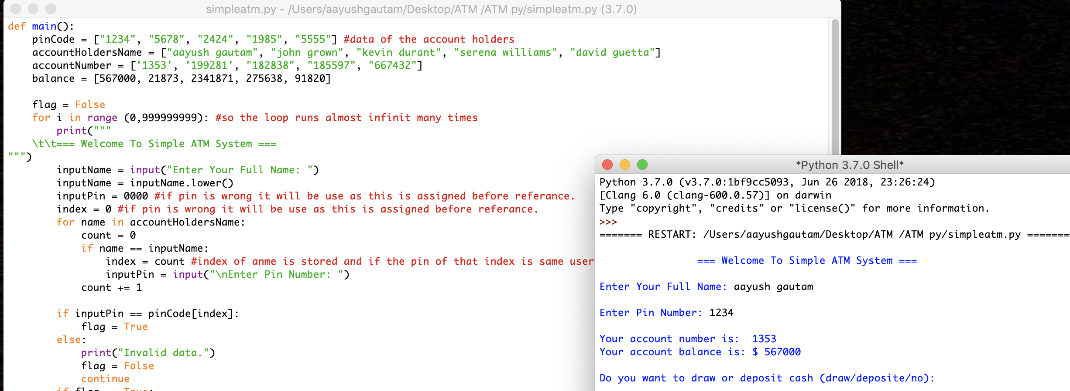
COLLECTION OF VARIOIUS USER DATA WITH THE HELP OF ARRAYS. WITH THE HELP OF ARRAYS INDICIES , PROGRAM EXECUTE THE RIGHT USERS INFORMATION.
For loop check the condition of the users.
After a valid input program prints out account number of my account and balance I have with me.

Slide 4
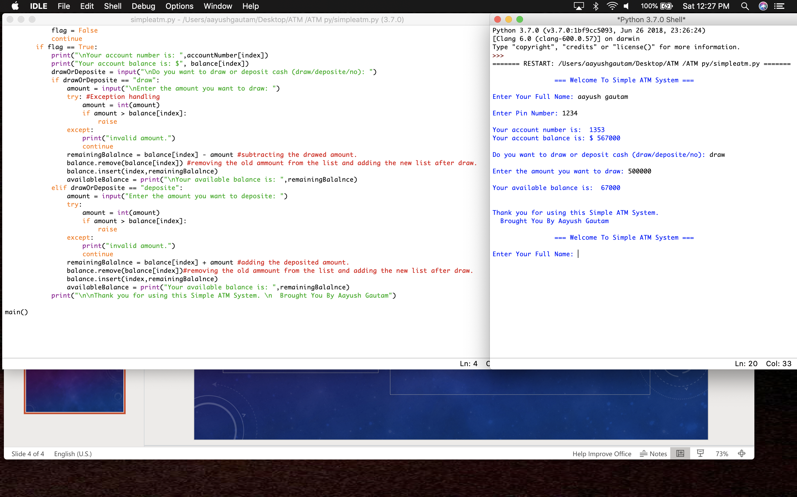
Drawing from the account
I have created the print function to ask a user weather to draw or deposit.
With the help of if condition I have created the function that enter value should be greater than available balance. To meet the condition.
Array index help to locate the user and display the transaction amount when it is completed.
If user want to draw more than available balance it will print out invalid amount.

Slide 5
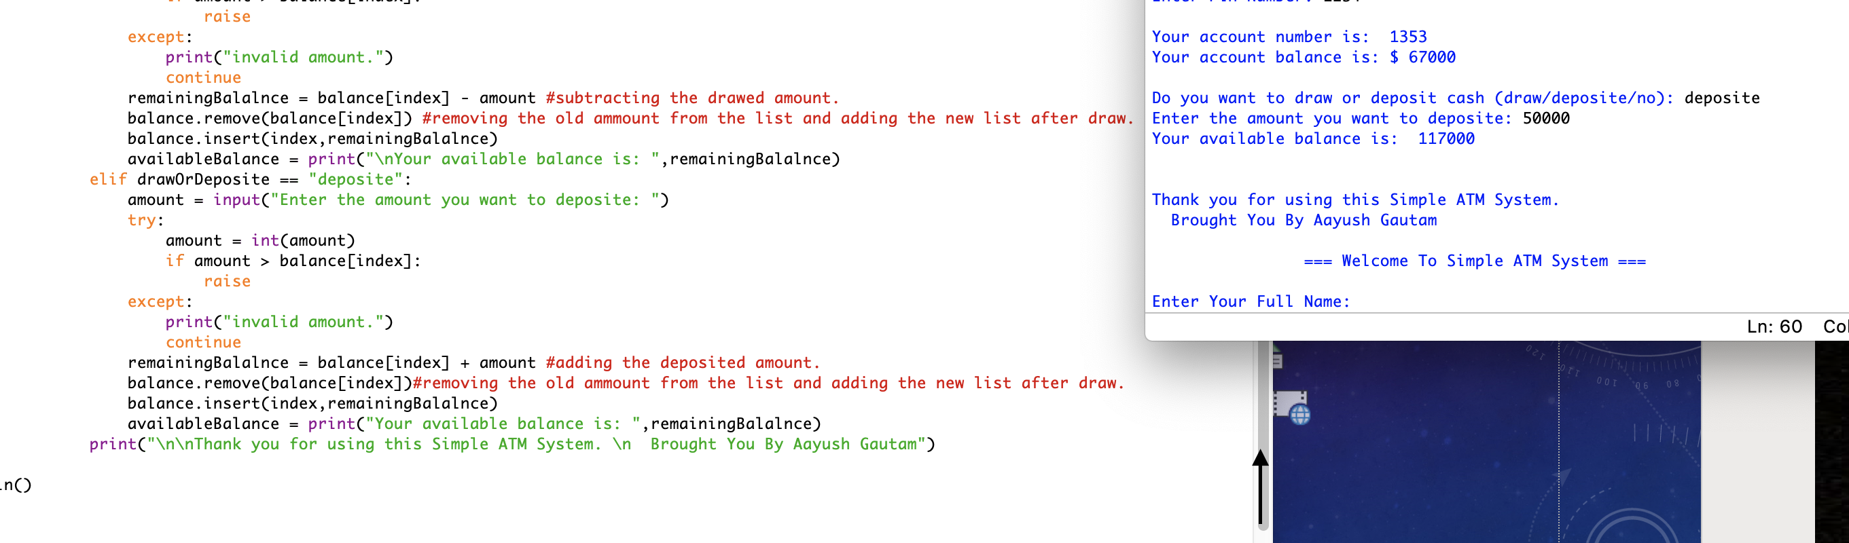
Deposits in accounts
From my last transaction I draw few amount and as you can see amount is displayed.
Now I am depositing more money in my account and once the deposit is completed it will display my final balance.
With the help of index and arrays it will find the right depositing account, as you can see in my code I have written a program to eliminate old balance and replace with new balance.

Slide 6
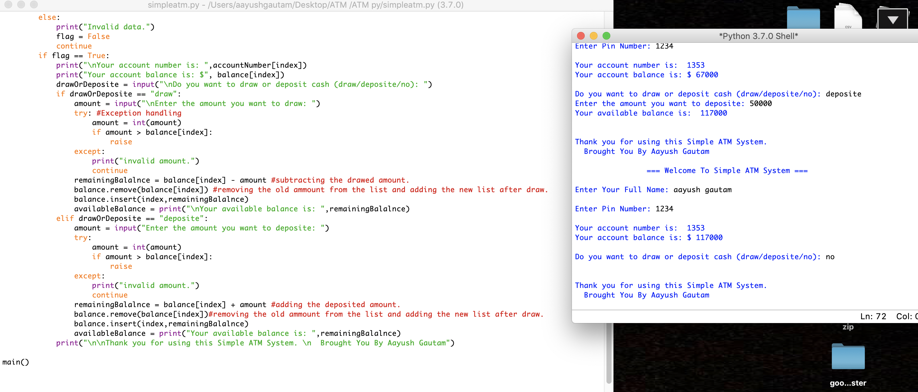
End of the program
If user just want to check the balance. It will display the user balance and programs ends with greetings.

Slide 7
References:
1. www.stackoverflow.com
2. www.codeacademy.com
3. www.udemy.com
4. www.youtube.com
5. all assignment provided by the instructror Johnny Williams

